Slide 1
Bike-Share Navigate Speedy Success?
Cyclistic Case Study: Capstone Project 1

Slide 2
The Case Study:
The director of marketing Lily Moreno, believes the company’s future success depends on maximizing the number of annual memberships. Therefore, Cyclistic marketing analytics, Cyclistic executive team wants to understand how casual riders and annual members use Cyclistic bikes differently.
Current problem Faced by Ms. Lily Moreno
Lack of knowledge of Customer Preference.
Need to study Cyclistic historical bike trip data to identify trends.
Lack of digital Media Marketing
Looking at the Problem, Ms. Lily Moreno has a team pulled in on-board.

Slide 3
Characters and Teams
Lily Moreno: The director of marketing
Cyclistic marketing analytics team: A team of data analysts
Cyclistic executive team: The notoriously detail-oriented executive team
Cyclistic: A bike-share program that features more than 5,800 bicycles and 600 docking stations.

Slide 4
Background
In 2016, Cyclistic launched a successful bike-share offering. Since then, the program has grown to a fleet of 5,824 bicycles that are geotracked and locked into a network of 692 stations across Chicago. The bikes can be unlocked from one station and returned to any other station in the system anytime.
There are two types of Cyclists: Memberships and Casual
Customers who purchase single-ride or full-day passes are referred to as casual riders. Customers who purchase annual memberships are Cyclistic members.

Slide 5
Decode the Case Study:
Project Idea: Design marketing strategies aimed at converting casual riders into annual members.
Current Need: data, Marketing tactics, general awareness and appealing to broad consumer segments.
Overview of the project: It’s an Cyclistic based Project. Current Project need some inputs that will guide the future marketing program.
Current Problems: better understand Customer wants, marketing tactics, bike trip data to identify trends.

Slide 6
Case Study RoadMap-Ask
1. How do annual members and casual riders use Cyclistic bikes differently?
2. Why would casual riders buy Cyclistic annual memberships?
3. How can Cyclistic use digital media to influence casual riders to become members?

Slide 7
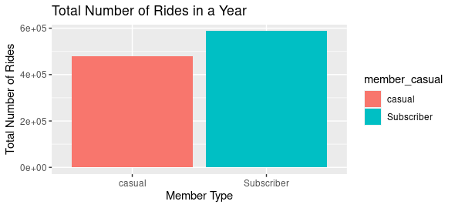
How do annual members(Subscriber) and casual riders use Cyclistic bikes differently?
This image illustrates that throughout the year, Subscribers or Members tends to use the total number of ride more frequently than Casual Riders

Slide 8
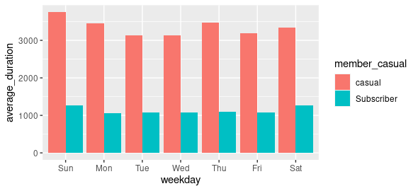
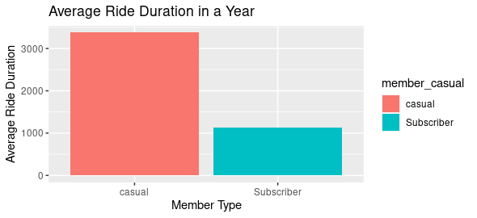
How do annual members(Subscriber) and casual riders use Cyclistic bikes differently? Average Duration in Weekday & Year! This image illustrates that average duration in a Weekday & Year, Casual Riders tends to use the total number of ride more frequently than Subscribers or Members.

Slide 9
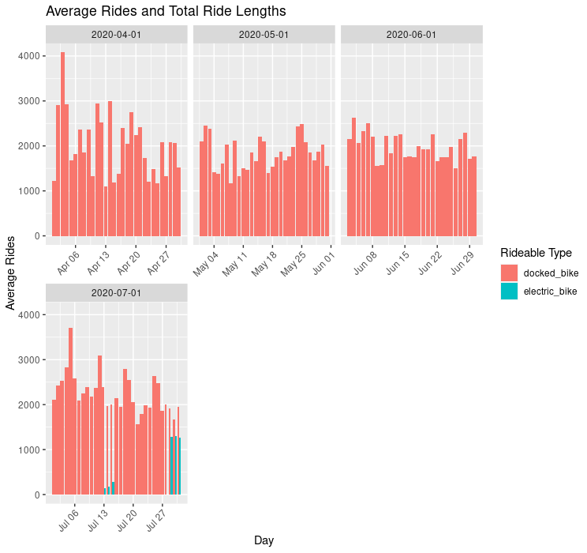
How do annual members(Subscriber) and casual riders use Cyclistic bikes differently?
This image illustrates that average duration Ride in a Monthly & Yearly, Docked bike Riders tends to use total number of ride more frequently than electric bike.

Slide 10
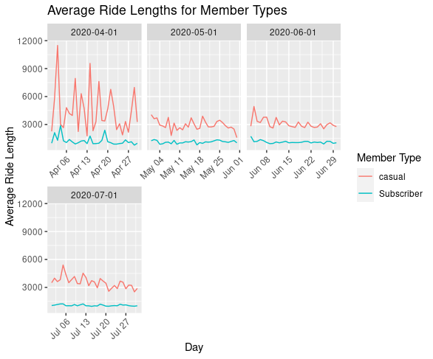
How do annual members(Subscriber) and casual riders use Cyclistic bikes differently?
This image illustrates that average duration Ride in a Monthly & Yearly For Members Types , Casual member tends to use total number of ride more frequently than Subscriber or Members.

Slide 11
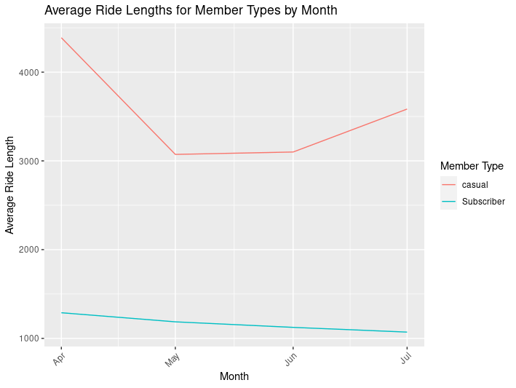
Why would casual riders buy Cyclistic annual memberships? Overall, Total Average ride of Casual Member is higher in weekday, Monthly and Yearly.

Slide 12
Why would casual riders buy Cyclistic annual memberships? According to data, Total Average ride of Casual Member is higher in weekday, Monthly and Yearly. Project Idea: Design marketing strategies aimed at converting casual riders into annual members. Decision to purchase casual rider into annual members may depends on various factors:
Cost Saving
Convenient
Membership Perk
Commitment to health and Fitness
Membership Promotion
Group Ride and Events
Improved Riding skill
Access to Resources
Implementing targeted marketing strategies to encourage casual riders to transition into annual memberships has the potential to enhance the company's profitability.

Slide 13
Case Study RoadMap-Prepare(Guiding Questions)
Where is your data located? https://divvy-tripdata.s3.amazonaws.com/index.html
How is the data organized?
This is public data that you can use to explore how different customer types are using Cyclistic bikes. There are some files that might be too large to view.
How are you addressing licensing, privacy, security, and accessibility?
The data has been made available by Motivate International Inc. under this license.
How did you verify the data’s integrity? ROCCC
Are there any problems with the data? Data is insufficient to provide relevant insights to Cyclistic.

Slide 14
Case Study RoadMap-Prepare(Guiding Questions)
Are there issues with bias or credibility in this data? Does your data ROCCC?
Reliability : Reliability is a crucial aspect, encompassing the substantial size of the data, as well as considerations related to data security and quality.
Originality : The data has been made available by Motivate International Inc. under this license.
Comprehensiveness : The data has the relevant aspects of the subject matter, expand the dataset by adding additional columns demonstrates a thoughtful approach to improving comprehensiveness.
Current :The data is currently updated. Last zipped file is December 5th 2023.
Cited :Yes Motivate International Inc

Slide 15
Case Study RoadMap-Prepare(Guiding Questions)
Key tasks
Download data and store it appropriately.(I store it in Desktop)
Identify how it’s organized.(Folder)
Sort and filter the data.(Excel, Spreadsheet, Python, SQL ,R Studio, PowerBI)
Determine the credibility of the data.(ROCCC)

Slide 16
Case Study RoadMap-Process(Guiding Questions)
What tools are you choosing and why? Python, SQL ,R Studio, Tableau(more Feature)
Have you ensured your data’s integrity? (ROCCC)
What steps have you taken to ensure that your data is clean? (Remove duplicate, Filter, Fix structural errors, handle missing data)
How can you verify that your data is clean and ready to analyze? (Remove duplicate, Remove Null, Remove unused column, handle missing data)
Have you documented your cleaning process so you can review and share those results?(Yes)

Slide 17
Case Study RoadMap-Process(Guiding Questions)
Check the data for errors.(Remove Duplicate, Null Value, Unused column)
Choose your tools.(PYTHON,SQL,R STUDIO)
Transform the data so you can work with it effectively.(calculate ride length (HH:MM:SS then change to total second and calculate mean mode ,max)
Document the cleaning process.(PYTHON,SQL,R STUDIO)

Slide 18
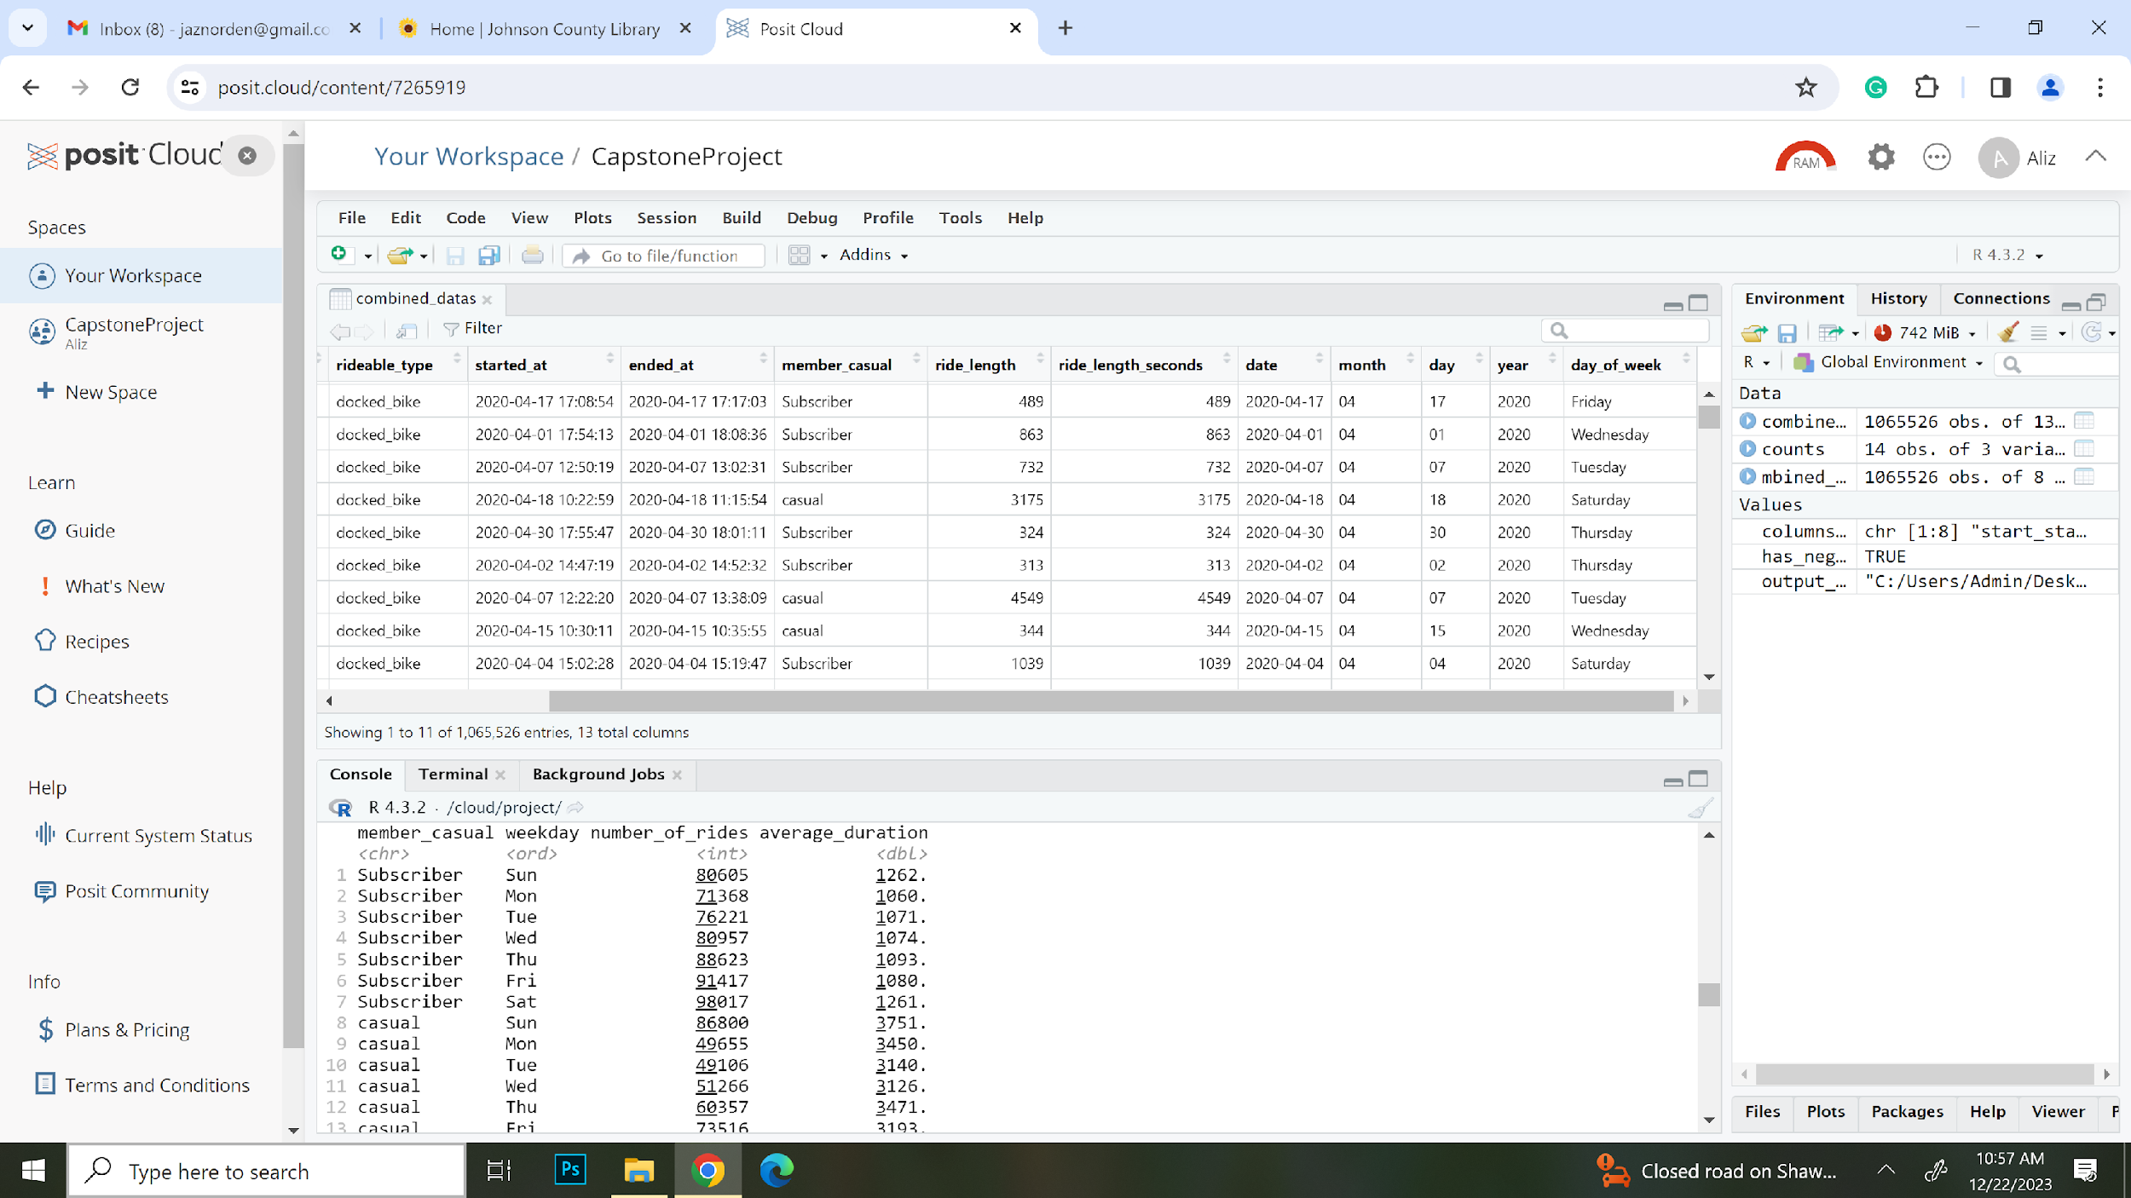
Case Study RoadMap-Process(Guiding Questions) Documentation of any cleaning or manipulation of data (R Studio )

Slide 19
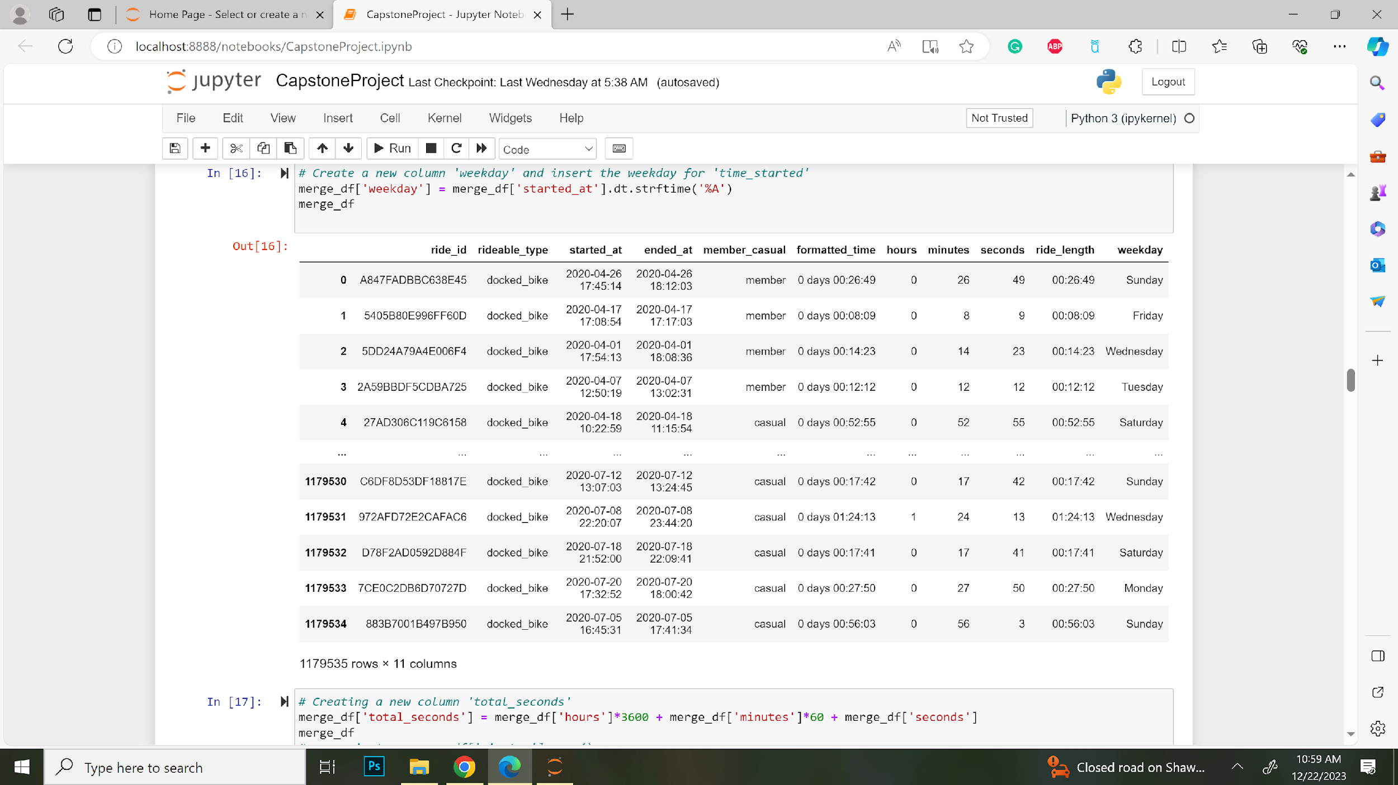
Case Study RoadMap-Process(Guiding Questions) Documentation of any cleaning or manipulation of data (Jupiter Notebook)PYTHON

Slide 20
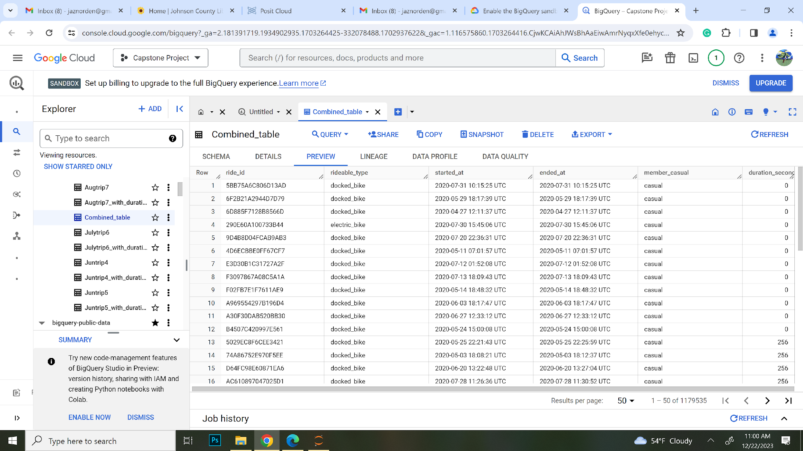
Case Study RoadMap-Process(Guiding Questions) Documentation of any cleaning or manipulation of data Big Query(Google Cloud)

Slide 21
Case Study RoadMap-Analyze(Guiding Questions)
How should you organize your data to perform analysis on it?
There is 2 approach that I used during organizing data:
Collect all data at once then start cleaning, filtering data.
Start cleaning each data manually and then combine all.
Has your data been properly formatted? YES
What surprises did you discover in the data?
Null Value, Unable to load Large data in Spread Sheet, Unable to load all data in Big query , change in Sql Query that help combine data at once.
What trends or relationships did you find in the data? All the data pattern looks same and its easy to manipulate clean data.
How will these insights help answer your business questions? It will guide for better marketing strategies.

Slide 22

Case Study RoadMap-Analyze(Guiding Questions) I use R Studio, SQL, PYTHON to analyst data.
SQL, Python, R studio is highly capable of handling big dataset.
R use powerful visualization packages , with ggplot2, where as Python Matplotlib and Seaborn for static plots. SQL is not typically used as a dedicated tool for data visualization. It is more commonly used for data retrieval, manipulation, and analysis.

Slide 23
Case Study RoadMap-Analyze(Finding) Result: The mean of ride length : Ride Duration in a year, Average Duration in weekday

Slide 24
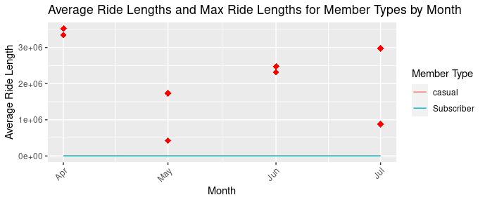
Case Study RoadMap-Analyze(Finding) Result: Maximum ride length for Member Types by Month

Slide 25
Case Study RoadMap-Share (Finding) Recommendations based on my Analysis
Were you able to answer the question of how annual members and casual riders use Cyclistic bikes differently? Casual member tends to use total number of ride more frequently than Subscriber or Members.
What story does your data tell? Casual member> Subscriber or Members.
How do your findings relate to your original question? Subscriber or data Insights can helps to strategize or prioritize certain weak areas.
Who is your audience? What is the best way to communicate with them? Member and Casual rider are both audience . By encouraging casual riders to transition into membership program, we stand to gain financial benefits for the program, enhance the programs financial sustainability, foster a more loyal and committed audience.
Can data visualization help you share your findings? Yes
Is your presentation accessible to your audience? Yes

Slide 26
Case Study RoadMap-Act
What is your final conclusion based on your analysis?
Overall, Total Average ride of Casual Member is higher in weekday, Monthly and Yearly.
How could your team and business apply your insights?With proper Guidance, Team Member can come with new strategies which can convert Casual Member to Membership.
What next steps would you or your stakeholders take based on your findings? Implementing with targeted marketing strategies to encourage casual riders to transition into annual memberships has the potential to enhance the company's profitability.
Is there additional data you could use to expand on your findings?
Additional data based on gender, ethic, age group etc can be more helpful.

Slide 27
--THE END--
Thankyou

